Slide 1

Notes:
Directions: Play music and have this slide up when families start funnelling into the meeting room​
Greet families as they join via mic or chat!​
​
Choice: ​
Start on gallery view with small talk OR play music while this screen is going.​
​
Goal:​
Set meeting up for success

Slide 2






Today’s
agenda
01
The impact of educational travel
04
Your itinerary
02
Travel and safety
05
Cost and payment options
03
Travel dates
06
How to enroll
EF Educational Tours
Notes:
Speaker:​
​Welcome everyone! We are excited to present [School Name’s] [20xx] trip to [Destination] with [Your/Teachers Name]
Today we are going to cover:
The impact of educational travel
Travel and safety
The trip itinerary
Cost & payment options
How to enroll
Q&A
If you have questions throughout, please hold them to the end and if we haven’t answered them, we will make sure to do so. ​And with that, let’s dive in!​

Slide 3
Student outcomes
98%
95%
Said their tour broadened their students’ world
Said it encouraged their students to embrace new challenges
So how are students impacted by their travel experiences? How do they grow not just academically, but as human beings? After our tours come home, we always follow up with teachers to get their perspective on these questions, and more.
97%
2/3
Said it helped their students grow as people
Said it helped their students develop the ability to have an impact on the world
EF Educational Tours
Notes:
Speaker:​
Let’s start by talking about student impact
Touchpoint:
You/Teacher gives their experience of the impact of travel on students—
Or here’s our summary: Educational travel is fun, and it has long-lasting positive effects. When our travellers share their stories, we consistently hear how they’ve grown more confident, and independent with expanded knowledge about the world, other cultures and themselves–all-important growth opportunities.
Here are a few stats that prove that students do come back changed by these experiences.

Slide 4
“Our recent trip to the Alps was unbelievably great! The itinerary for our time in Germany, Italy, and Switzerland was jam packed with awesome sights and locations. Most kids like most of the meals provided which was a huge win! The Tour director, Sebastian, was second-to-none!”
John, Thunder Bay, Canada

Slide 5

Safety and Support
Notes:
Speaker: Now, let’s shift gears and talk about something really important: safety and support. (If your Tour Consultant is here, this is where [their name] will jump in to take over.)
Before we dive into the amazing itinerary your Group Leaders have chosen for this trip, I want to highlight why EF is our trusted partner when it comes to safety and support.
Your Group Leaders have selected EF Educational Tours for two (2) main reasons:
EF’s mission is to open the world to student travellers and create life-changing experiences through hands-on, experiential learning.
Even more importantly, EF’s unwavering commitment to safety—because we know that unforgettable experiences can only happen when safety comes first.

Slide 6
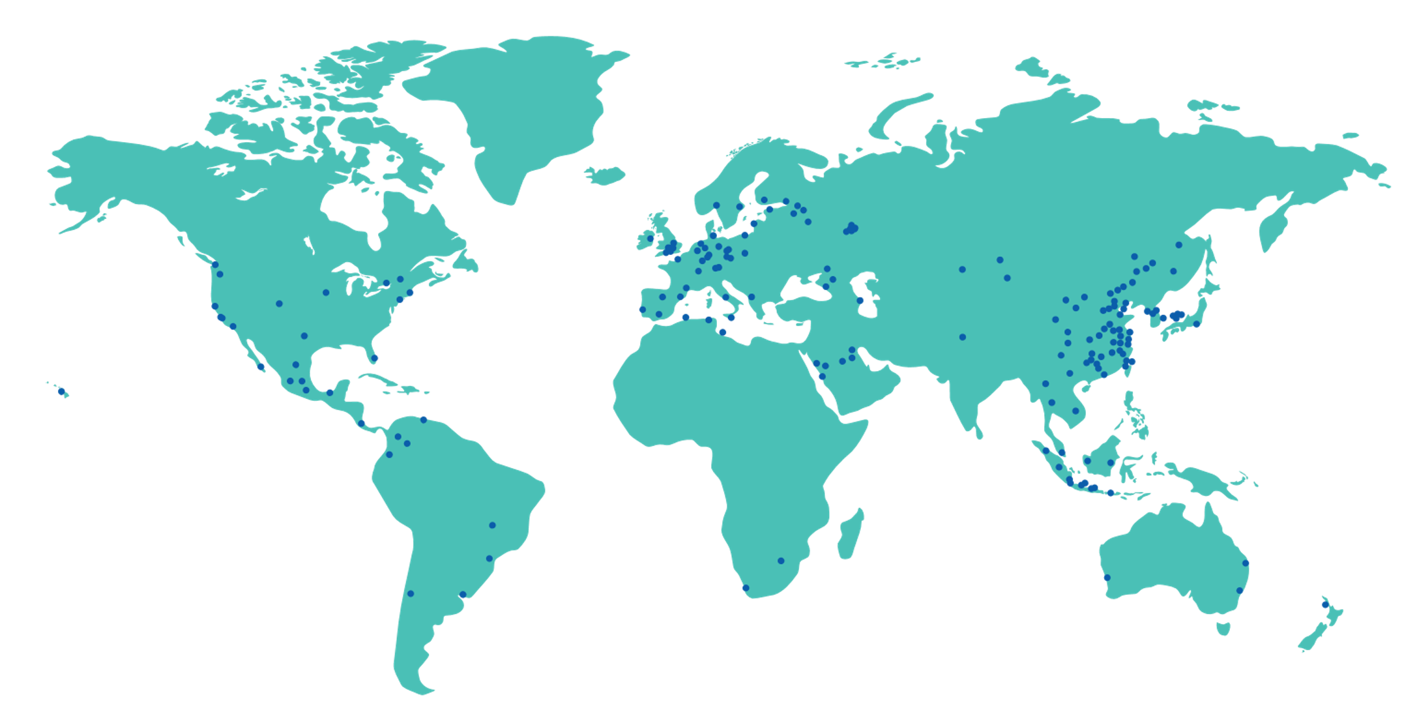
Our global presence
In almost any time zone, in almost any country or region, EF is there. We have dedicated EF team members located around the world, ready to help our students and customers in any situation, on any day. Our global presence prioritizes safety and our global negotiating powers delivers affordability.
51,500
600
120
Team members around the world
School and offices in 50 countries
Countries with an EF presence
EF Educational Tours
Notes:
Speaker:
EF believes the world is a better place when people make the effort to understand one another. Since 1965, EF has helped millions of people explore new destinations, experience different cultures, and discover more about the world—and themselves—all while keeping safety top of mind.
EF’s global reach is truly one-of-a-kind. With staff on the ground 365 days a year in over 50 countries, we don’t just operate in those places—we live there. EF team members call nearly all of our tour destinations home. That means we have the local expertise to keep your group safe, and you’ll always find a friendly face nearby—ready to lend a helping hand (or give a high-five).

Slide 7
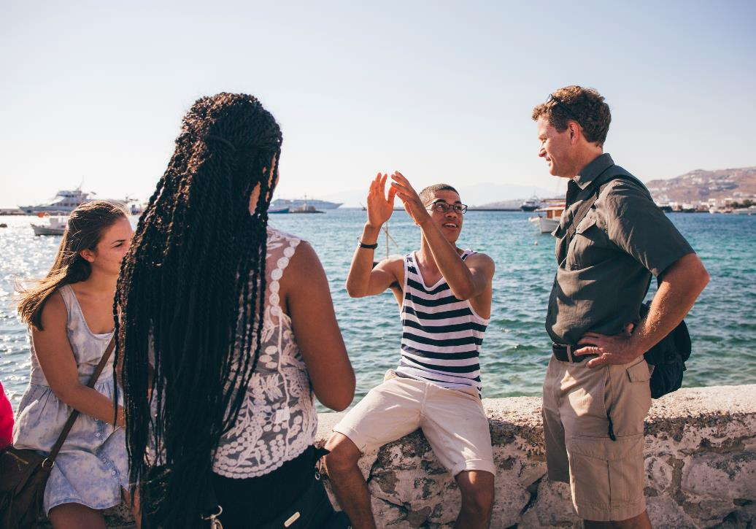

Safety is our #1 priority
EF has the largest safety & security team in the industry with 24/7, 364 coverage
Only company in the industry with dedicated staff for safety and security.
Local offices in virtually every travel destination offered globally
EF staff personally visit every hotel, restaurant, attraction, and bus company utilized
The EF Peace of Mind Program ensures that even if plans change unexpectedly, all our groups can plan with confidence
© 2023 Signum International AG | EF Educational Tours | eftours.ca
Registration Numbers: TICO-2395858 | CPBC-73991 | OPC-70273
Notes:
Speaker: At EF, we lead the way when it comes to student safety.
This trip is going to be full of fun and adventure, but our number one priority is always safety. Whether it’s navigating a worldwide pandemic or something smaller like a sprained ankle, a missed flight, or even confusing medical forms—we’ve seen it all, and we’re fully equipped to handle it.
In short, whatever comes up, we’re ready.
EF is always on. Our Safety and Incident Response Team—made up of experts across industries, healthcare, and more—is on call 24/7, 365 days a year, ready to jump into action.
With offices in nearly all of our travel destinations, we’re able to respond quickly with the help of a dedicated EF team on the ground.
EF carefully vets all service providers to ensure high standards for every traveller’s experience

Slide 8
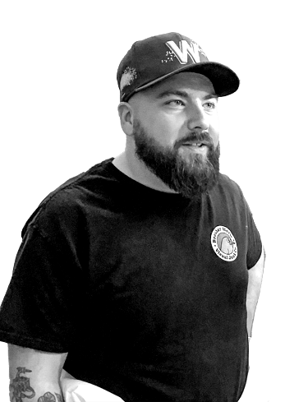

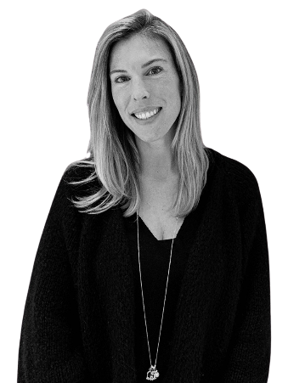
EF on the ground
Dan M
Director,
Program Activation
EF’s support network never sleeps. When you are boarding planes and catching trains, we send our Canadian staff out to key destinations to meet you on the road, even in places where we already have offices.
Jen E
Director,
Customer Experience
Vukasin P
Director,
Traveller Support
EF Educational Tours
Notes:
Speaker:
You don’t know it yet, but EF’s dedicated team is already working hard to ensure you have the best educational tour experience possible.
Dan, our Director of Program Activation, works closely with school boards to ensure we align with the highest standards and practices.
Vukasin, Director of Traveller Support and Emergency Response, leads the team handling everything from enrolment to emergency response, drawing from years of experience supporting Canadian travellers.
Jen, Director of Customer Experience, makes sure every operational detail—like flights, hotels, and tour components—runs smoothly behind the scenes.
On tour, your expert Tour Director will be with your group from start to finish, bringing local knowledge, personality, and logistical skills that make the trip unforgettable. Back home, our Traveller Support team is always available to answer any questions, while your Group Leader and chaperones ensure your child’s having the best time on their tour.

Slide 9

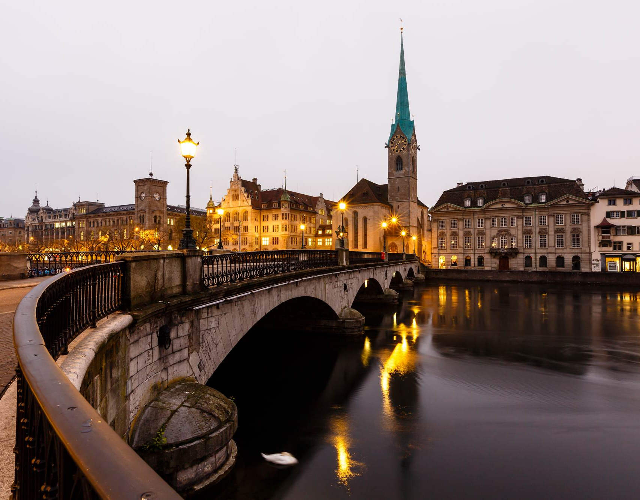
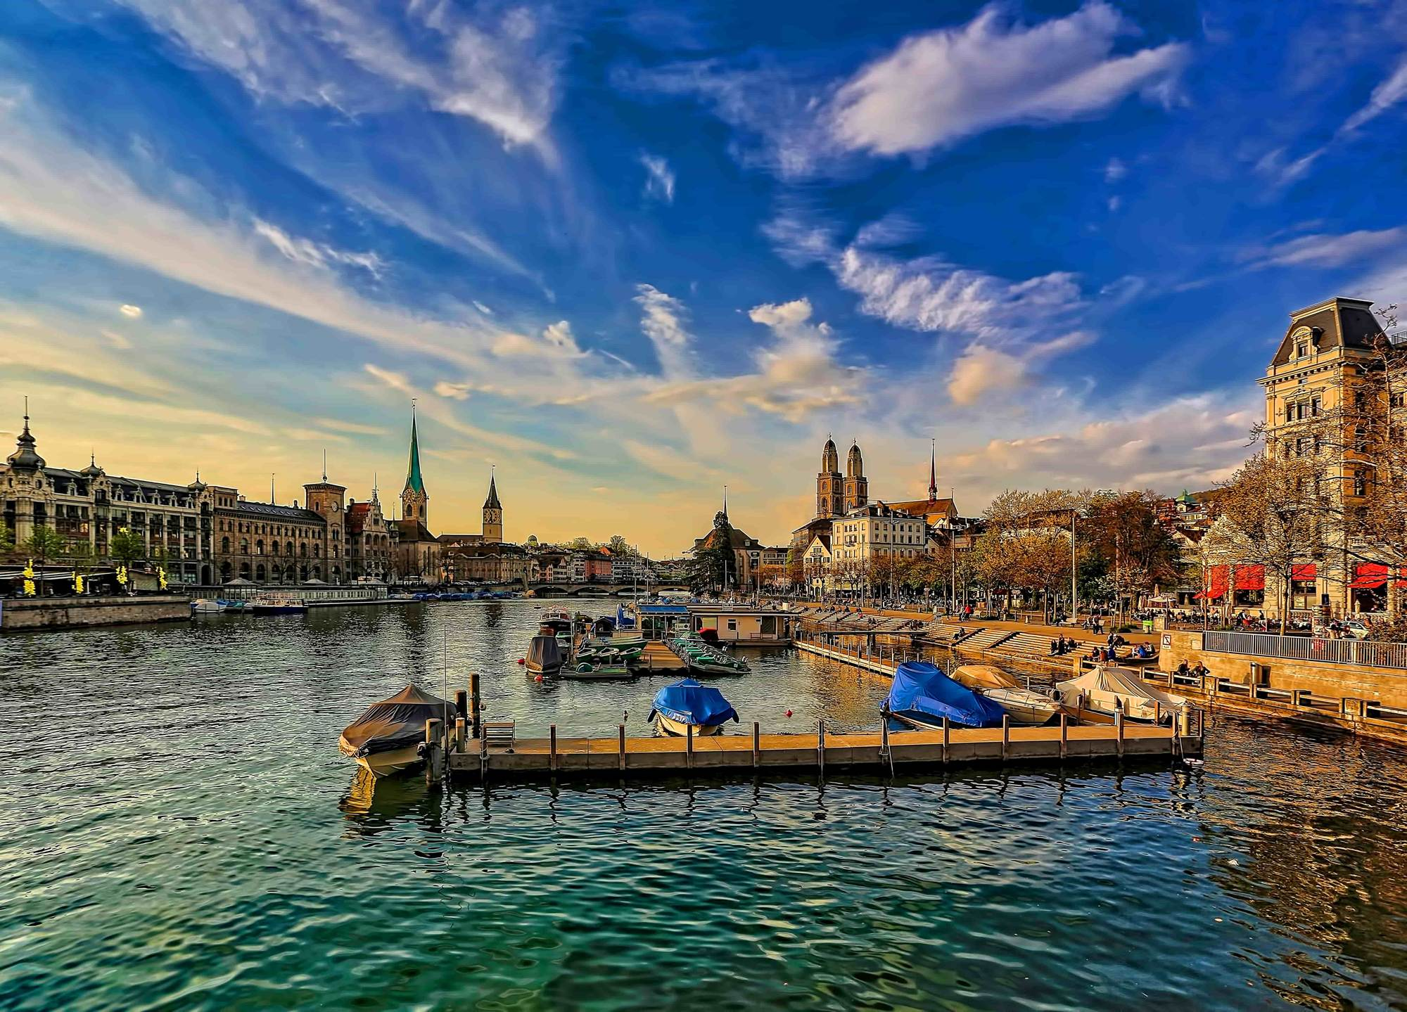
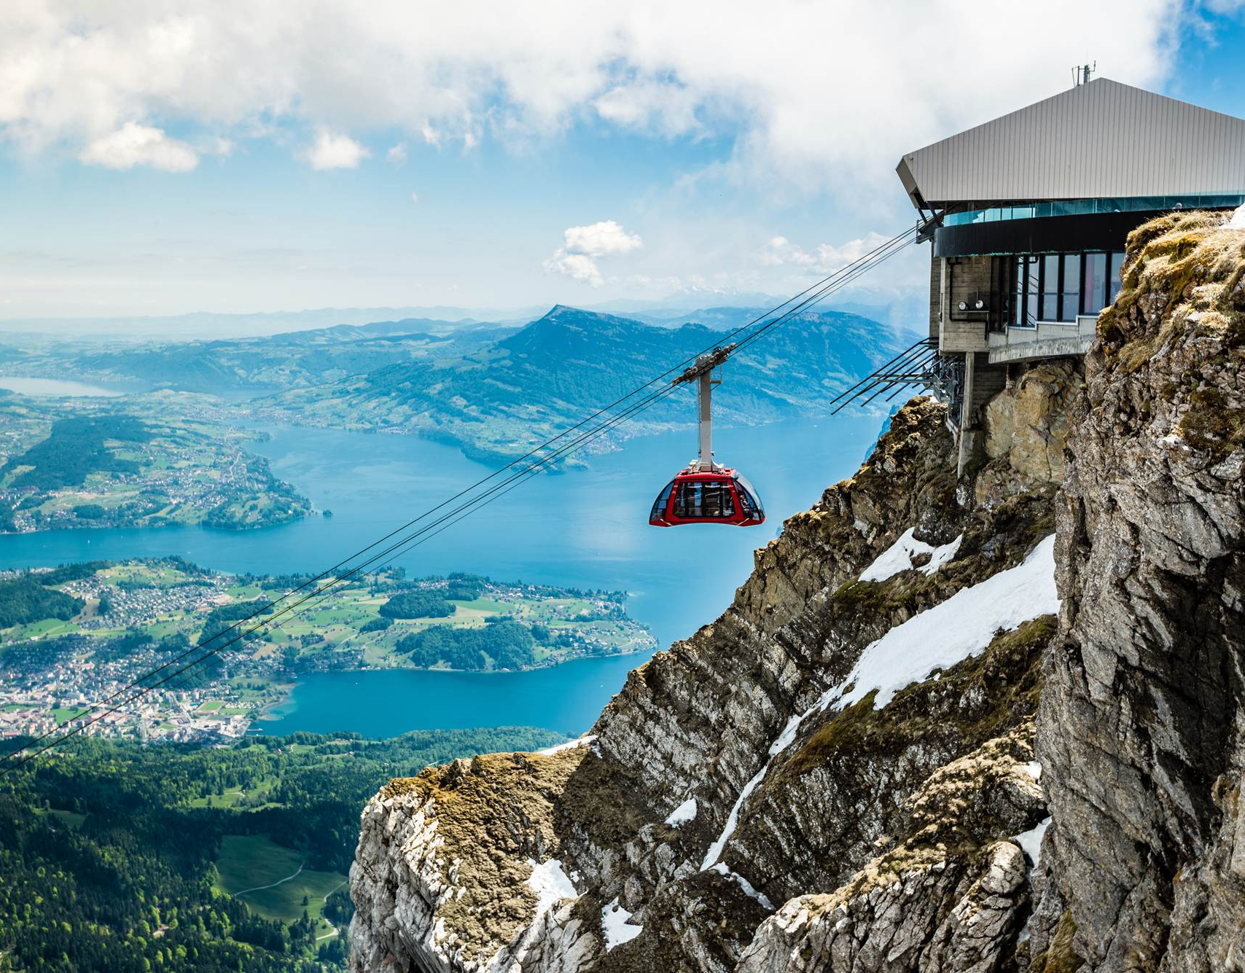
Switzerland, Italy and France
Day 1 Fly overnight to Switzerland
Day 2 Zurich | Lucerne
Meet your Tour Director at your destination
Take a walking tour of Zurich
Travel to Lucerne
Day 3 Lucerne
Enjoy a cruise on Lake Lucerne, then
ride to the top of a Swiss mountain.
Savour a taste of Swiss culture as you enjoy a fondue meal, the country’s national dish that consists of delicious melted cheese and a lot of bread. Then, experience a bit of Swiss tradition in the form of: yodelling and Alpine horns, or folk games.
EF Educational Tours
Notes:
SPEAKER:​
Now let’s dive into some of the details on what you can expect to experience on tour…

Slide 10

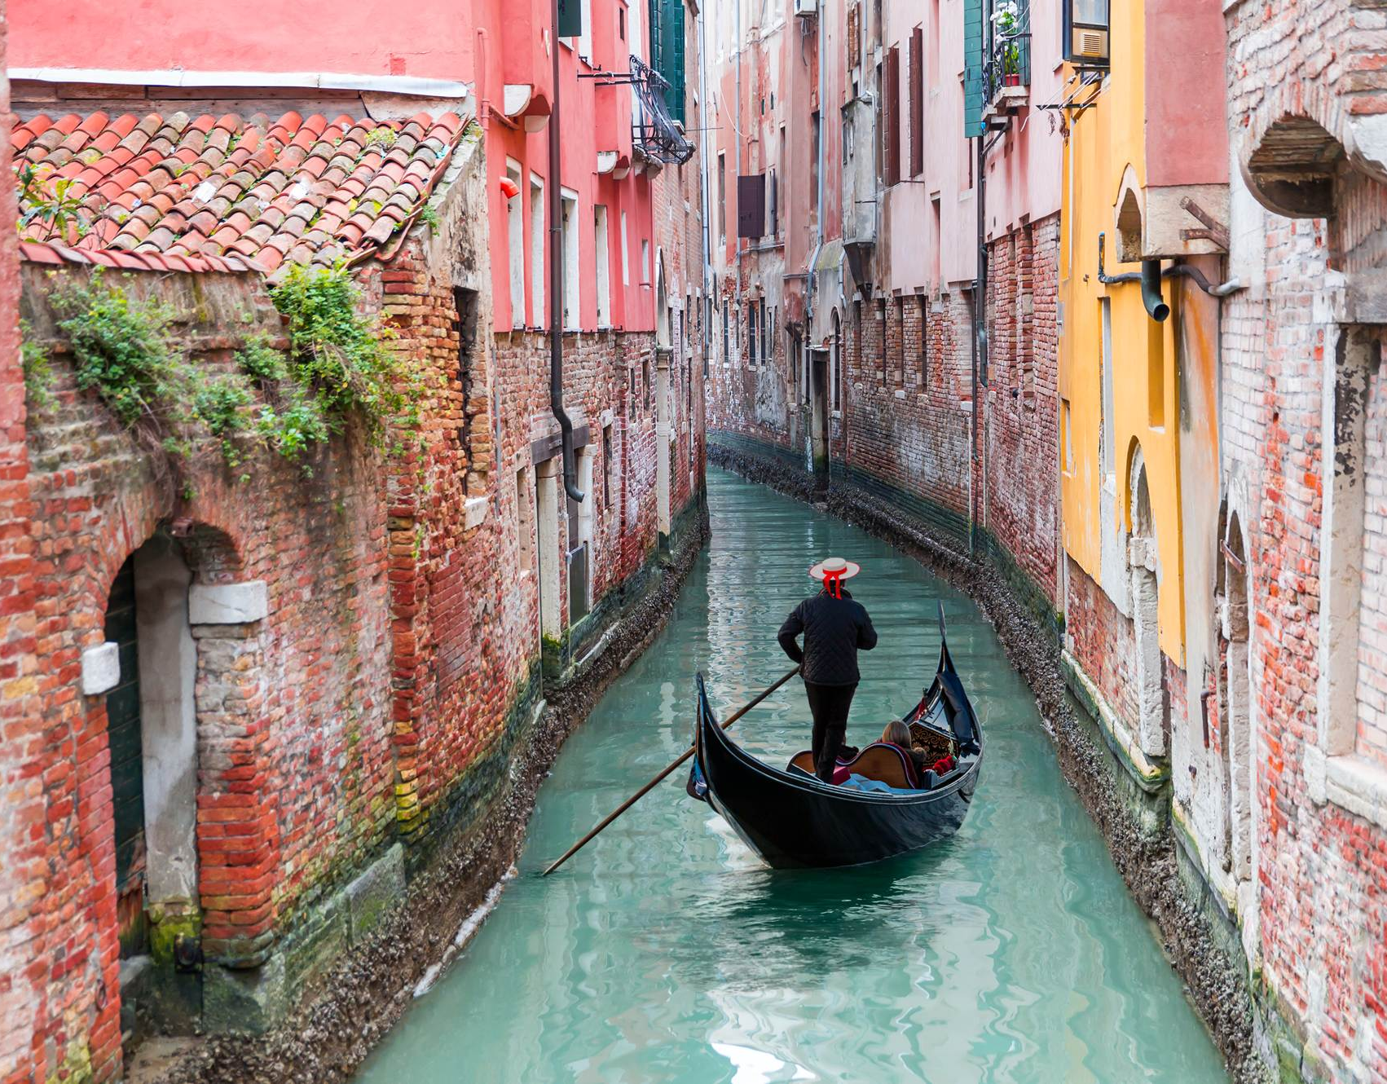
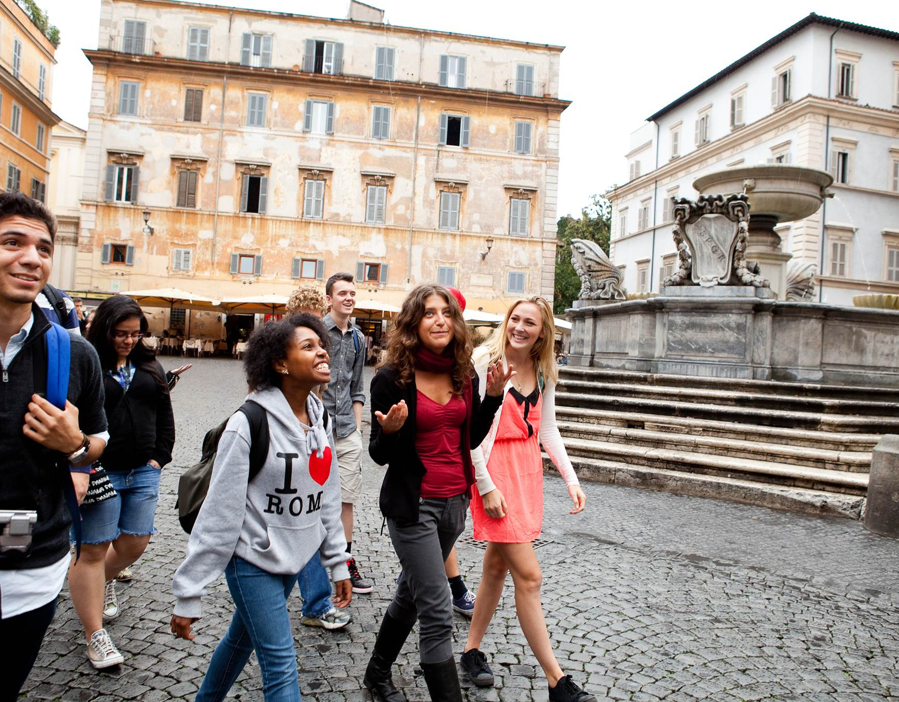
Switzerland, Italy and France
Day 4 Travel to Venice via Verona
Day 5 See a glass-blowing demonstration
Travel by water taxi to the island of Burano
Enjoy a Traditional Venetian Gondola Ride
Day 6 Travel to Rome
EF Educational Tours
Notes:
SPEAKER:​
Now let’s dive into some of the details on what you can expect to experience on tour…

Slide 11
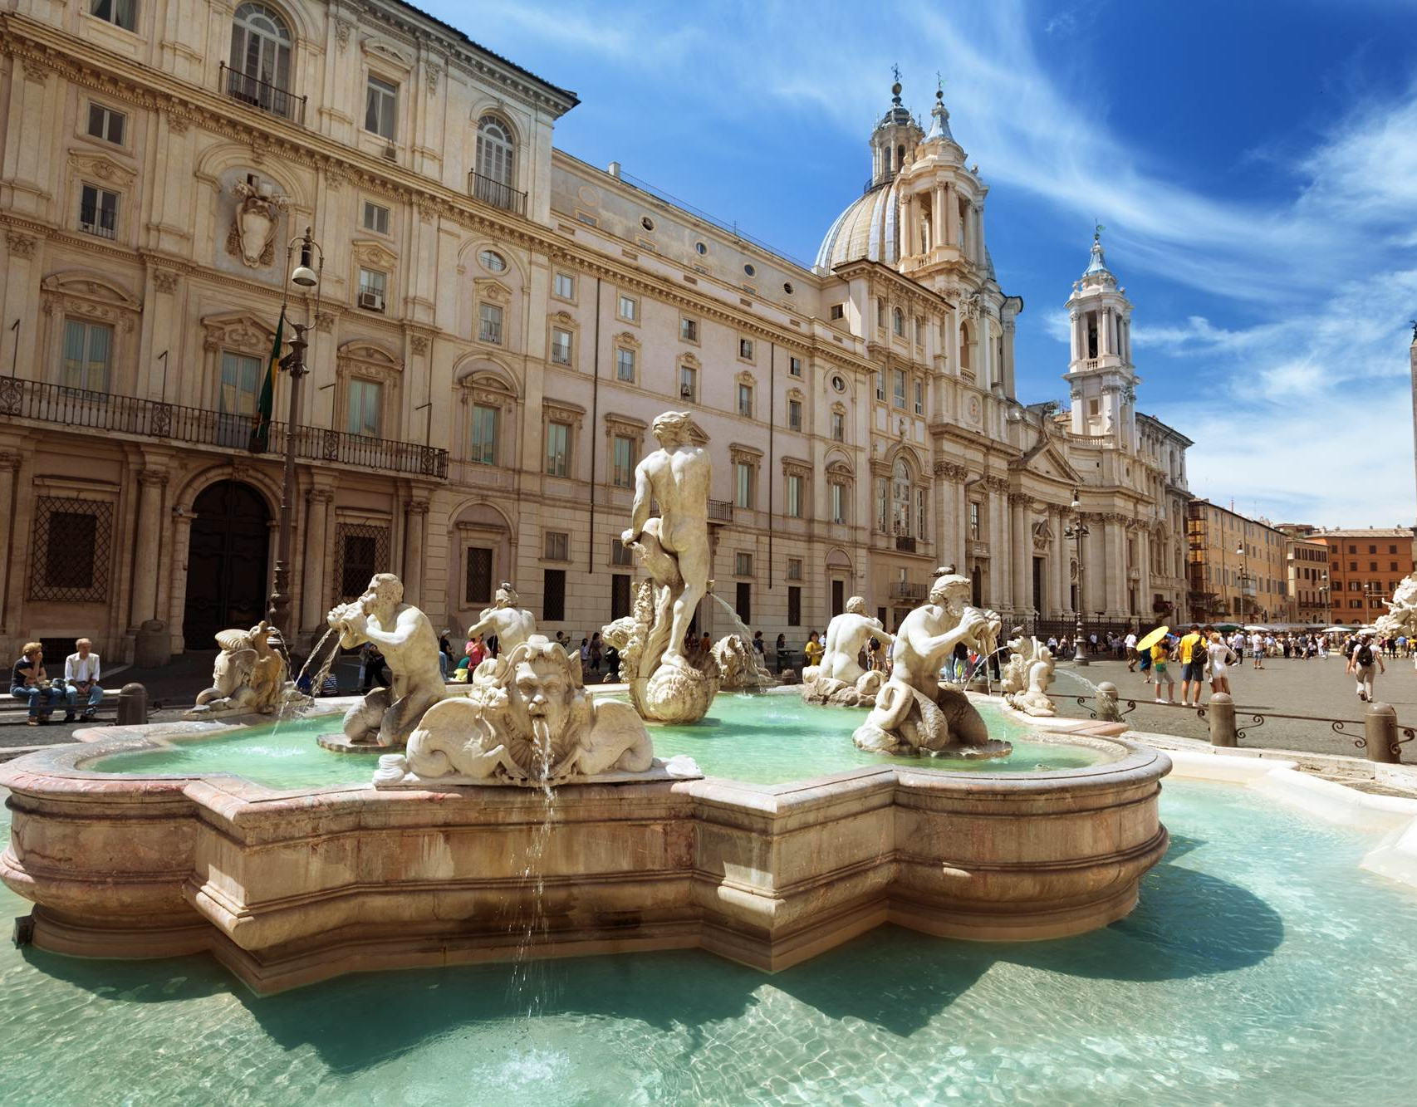
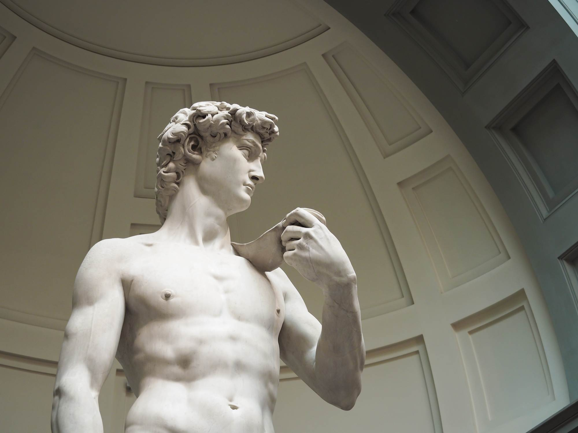

Switzerland, Italy and France
Day 7 Explore Rome during a food-themed walking tour
Day 8 Take a guided tour of Florence
With your expert local guide you will see:
Piazza della Signoria
Ponte Vecchio
Basilica of Santa Croce
Gates of Paradise
Day 9 Travel to the French Riviera via Pisa
See the Leaning Tower of Pisa
Visit the Baptistery of St. John and the Pisa Cathedral
EF Educational Tours
Notes:
SPEAKER:​
Now let’s dive into some of the details on what you can expect to experience on tour…

Slide 12
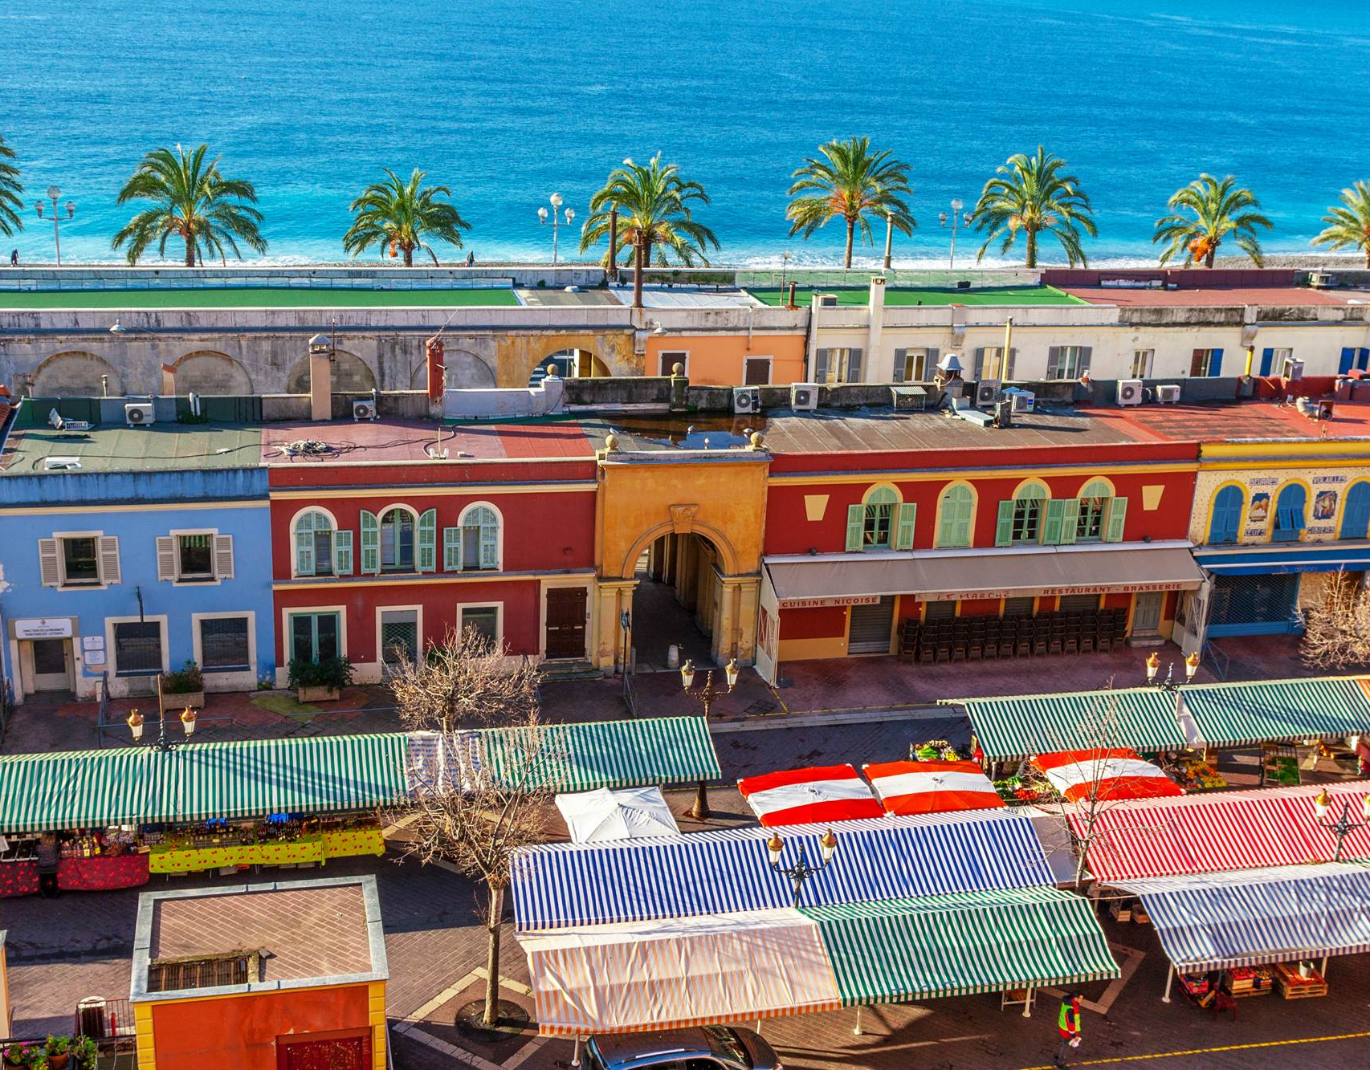
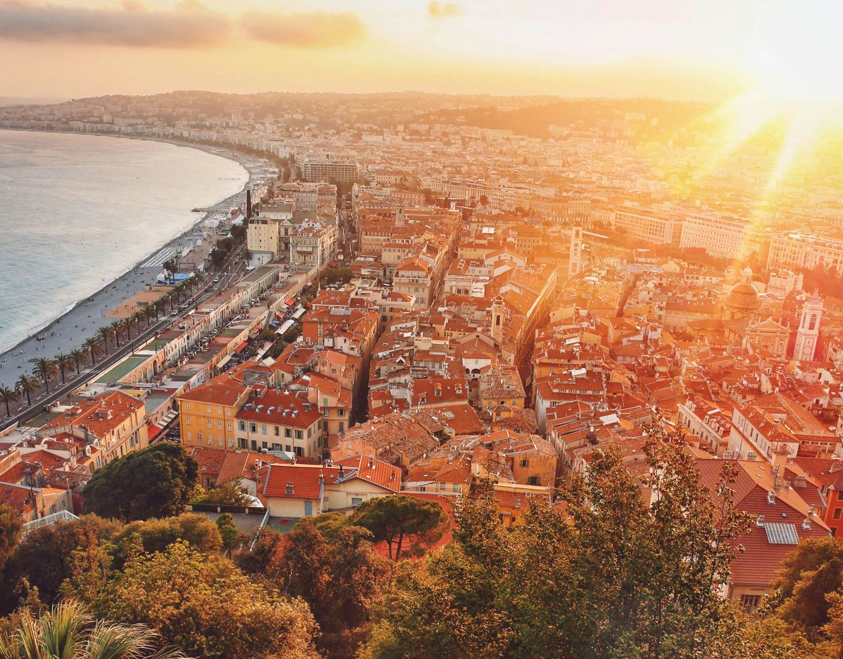
Switzerland, Italy and France
Day 10 Take a day trip to Monaco and Eze
Visit a French perfume factory
Take a walking tour of Nice
With your tour director you will see:
Vieille Ville
Promenade des Anglais
Day 11 Depart for home
EF Educational Tours
Notes:
SPEAKER:​
Now let’s dive into some of the details on what you can expect to experience on tour…

Slide 13

Everything included:
Airfare and on-tour transportation
Hotel accommodations
Group meals
Full-time Tour Director
Guided tours, activities and entries
Travel gear
© 2023 Signum International AG | EF Educational Tours | eftours.ca
Registration Numbers: TICO-2395858 | CPBC-73991 | OPC-70273
Notes:
Speaker:
So, what’s included? Pretty much everything!
Directions: read through each one. ​
[It is important to share the value of all that is included before the price is shared.]

Slide 14

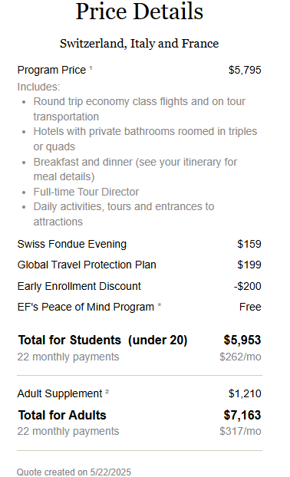
$262 /month*
Price valid until: May 31, 2025
Notes:
Speaker:
Space is limited on this amazing adventure, but you can secure your spot with just a $199 deposit with monthly payments as low as $____________ a month.
Highlight what else is included in this pricing – insurance/cfar, optional tours, extensions, etc.

Slide 15
Enroll by June 30 for
$200 off!!
© 2023 Signum International AG | EF Educational Tours | eftours.ca
Registration Numbers: TICO-2395858 | CPBC-73991 | OPC-70273
Notes:
Speaker:
I’ve partnered with EF to provide an exclusive and time-limited early enrolment discount from ______ to __________ for __________ off of our tour!

Slide 16
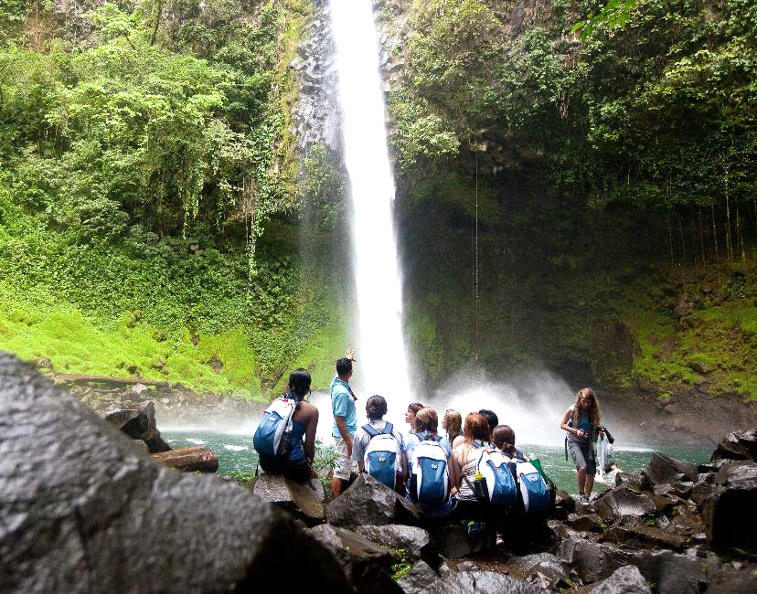
Ready, set, prepare:
Spending money
Free time excursions
Customary gratuities
Lunches and snacks
Passports and Visas
EF Educational Tours
Notes:
Let’s talk about what’s covered on your trip and what you'll need to plan for.
A few things to keep in mind:
Spending money: Make sure to budget some spending money for your trip. While most activities are included, if your Tour Director suggests extra activities during free time, there may be optional entry fees.
Tipping: It’s customary to tip your hardworking Tour Director, local guides, and bus drivers. Please budget around $15 CAD/day for tipping. The Group Leader will update and collect this about a month before departure.
Meals: While EF covers breakfast and dinner, students are responsible for lunch and snacks. We recommend bringing around $40-$60 CAD/day for meals. This allows flexibility to explore local cafés or grab a quick bite like gelato on the go. We’ll go over best practices for carrying money and handling currency conversion closer to the trip.
Travel Documents: Canadian citizens generally won’t need a visa for most tours. However, if you’re not a Canadian citizen, you’ll need to look into any necessary travel documents as EF can’t arrange them for you.
Passports and Visas:
Passports must be valid for at least 6 months after your return date.
EF needs your passport details 3 months before departure.
Ensure your government-issued IDs match the name on your passport. If a student goes by a different name, let your Group Leader (me) know so we can use their preferred name on tour.
You don’t need to have all your documents to enrol, but they must be submitted to EF at least 3 months before the trip. It’s important to get your passport new or renewed as early as possible!

Slide 17

Coverage and
policy flexibility
Global Travel Protection Plan (Individual Coverage) With this plan, you have access to representatives knowledgeable of these benefits 24 hours a day, so you can relax
and enjoy the trip of a lifetime!
Cancel For Any Reason (CFAR) (Insurance Add-On)
This provides additional tour cancellation protection.
As of September 1st, 2023, the Global Travel Protection Plan, including the CFAR Insurance Add-On, is underwritten by Zurich Insurance Company Ltd (Canadian Branch).
© 2023 Signum International AG | EF Educational Tours | eftours.ca
Registration Numbers: TICO-2395858 | CPBC-73991 | OPC-70273
Notes:
Speaker:
(Highlight if these options are included as mandatory for your tour)
EF offers a range of options so families can feel confident and prepared.
With EF’s Global Travel Protection Plan, you’re covered no matter where you are in the world. Our on-tour support and emergency assistance teams are available 24/7, so you can relax and focus on enjoying your trip of a lifetime!
The Global Travel Protection Plan includes:
Illness and Accident Coverage
Baggage and Property Coverage
Tour Cancellation and Interruption Coverage
School Board Tour Cancellation Coverage
24-hour Emergency Assistance
For added peace of mind, EF also offers the Cancel For Any Reason (CFAR) Insurance Add-On. This optional coverage allows travellers to cancel their tour for any reason up to 24 hours before departure and recover up to 80% of non-refundable fees.
Please note: The Global Travel Protection Plan and CFAR Insurance Add-On are only available (and can only be removed) for up to 30 days after enrolling in your EF Tour. You can add CFAR up to 70 days before departure.

Slide 18

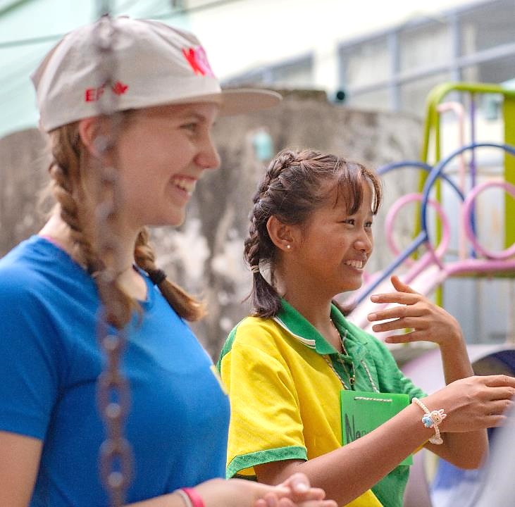
Flexible payment options
Option 1: Automatic Payment Plan
Choose the payment frequency (monthly or bi-weekly) deducted from your bank account. Final payment is due 25 days prior to departure.
Option 2: Pay in full at enrolment
Option 3: Manual Payment Plan
Receive invoices and make your payments in less frequent instalments based on the date of enrolment.
Option 4: Pay with FlexPay
Book now, pay overtime. Spread the cost of your trip over low monthly payments, even after you’ve travelled.
Payment methods accepted: direct debit, chequing or savings account, or credit card (Visa or MasterCard)
© 2023 Signum International AG | EF Educational Tours | eftours.ca
Registration Numbers: TICO-2395858 | CPBC-73991 | OPC-70273
Notes:
Speaker: Let’s talk about how to make this trip happen! EF offers flexible payment options to fit your needs:
Automatic Payment Plan This plan spreads payments over [X] months after the initial $199 non-refundable deposit. Payments are automatically deducted from your bank account, and you choose the frequency—either monthly or bi-weekly.
Manual Payment Plan With the Manual Payment Plan, there are no automatic deductions. You have the flexibility to make as many or as few payments as you like, as long as they meet the payment deadlines.
Pay-in-Full This one is simple. You can choose to pay the full amount upfront, which includes the $199 non-refundable deposit.
FlexPay Looking for more flexibility? FlexPay allows travelers to finance their tour over a longer period, even extending beyond the trip date, offering lower monthly payments than the automatic payment plan.
For more details on FlexPay, visit: https://www.eftours.ca/help-centre/policies/payment-plans
EF’s Traveller Support Team is always here to help if you need more options!

Slide 19
Travel dates
Mar 21, 2027
Mar 25 to Apr 4
Apr 6, 2027
11 days on tour
Earliest departure
Requested dates
Latest return
Departing city: Edmonton
Note:
We’ll confirm the exact departure and return dates closer to the tour. EF strives to keep the new departure dates within one to two days of the original date on tours departing October through April and within four days of the original date on tours departing May through September.
© 2023 Signum International AG | EF Educational Tours | eftours.ca
Registration Numbers: TICO-2395858 | CPBC-73991 | OPC-70273
Notes:
Speaker:
Let’s get ready for the trip of a lifetime?! Mark your calendars! Block off these days in your family schedule
We have requested our X-day tour to take place between X date and X date. EF will book our flights within a small window around our requested dates. They like this bit of flexibility in order to ensure securing the best flight paths and services.
We’ll know our set dates approximately two (2) months before the tour!​

Slide 20
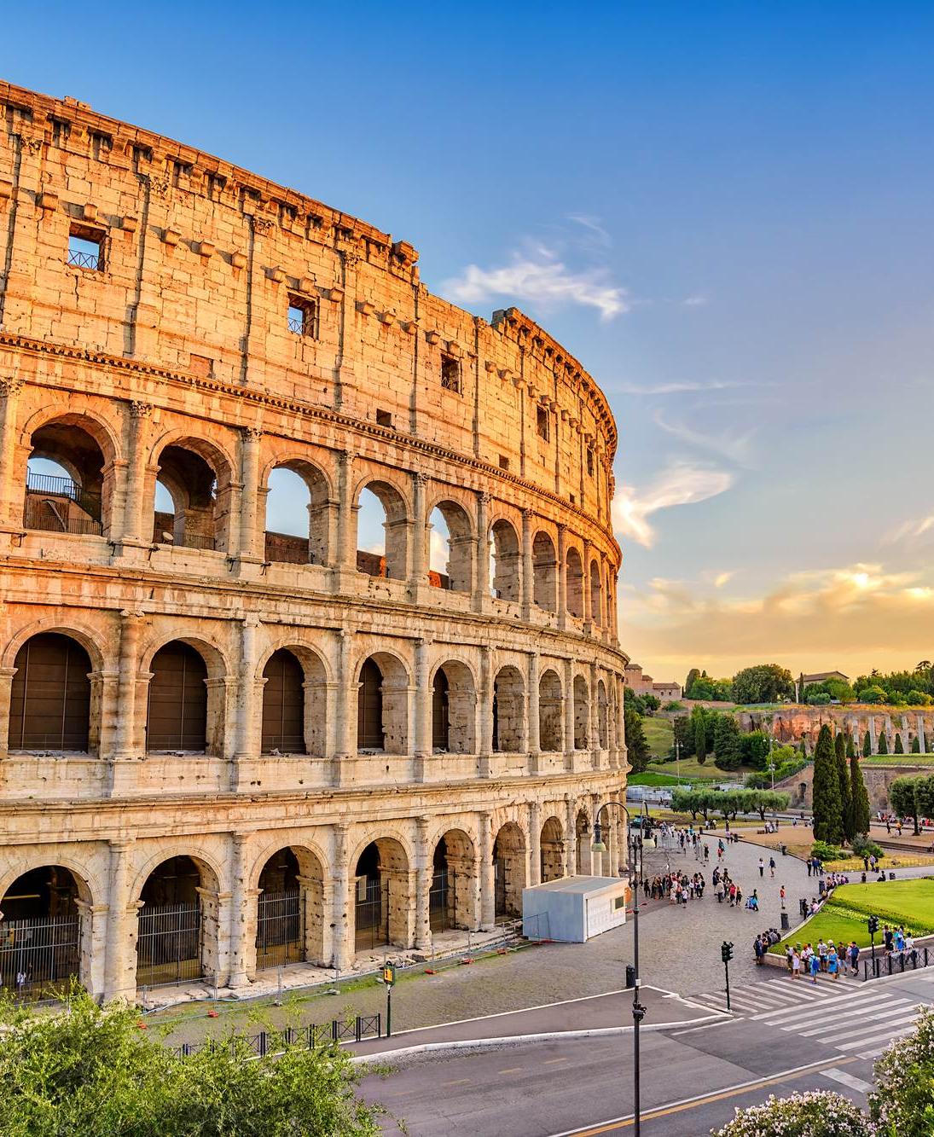
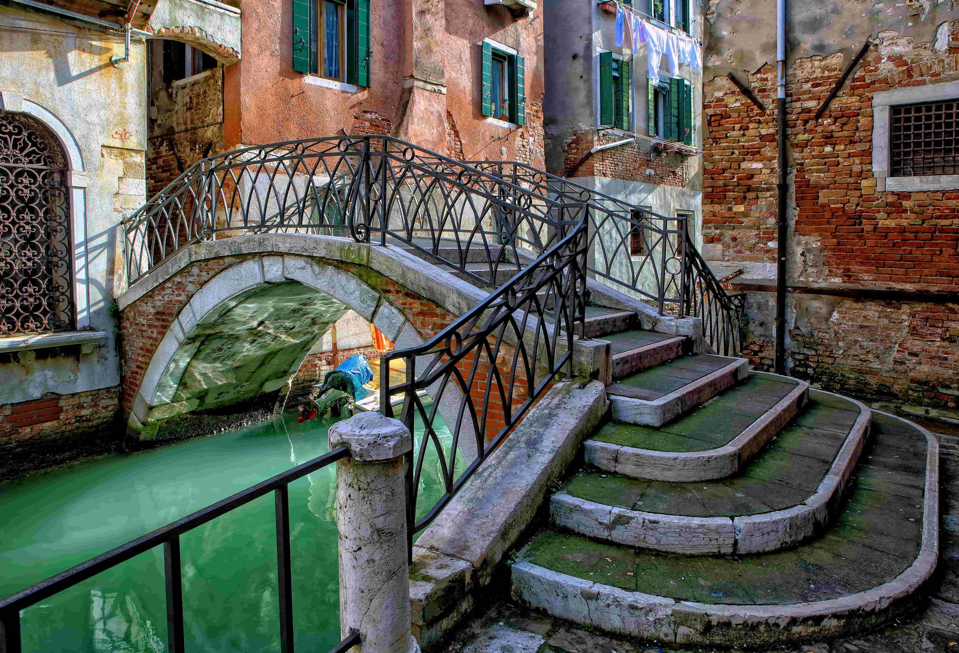
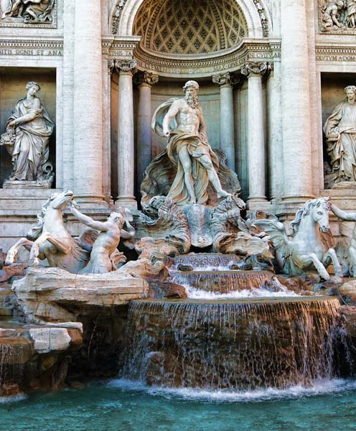
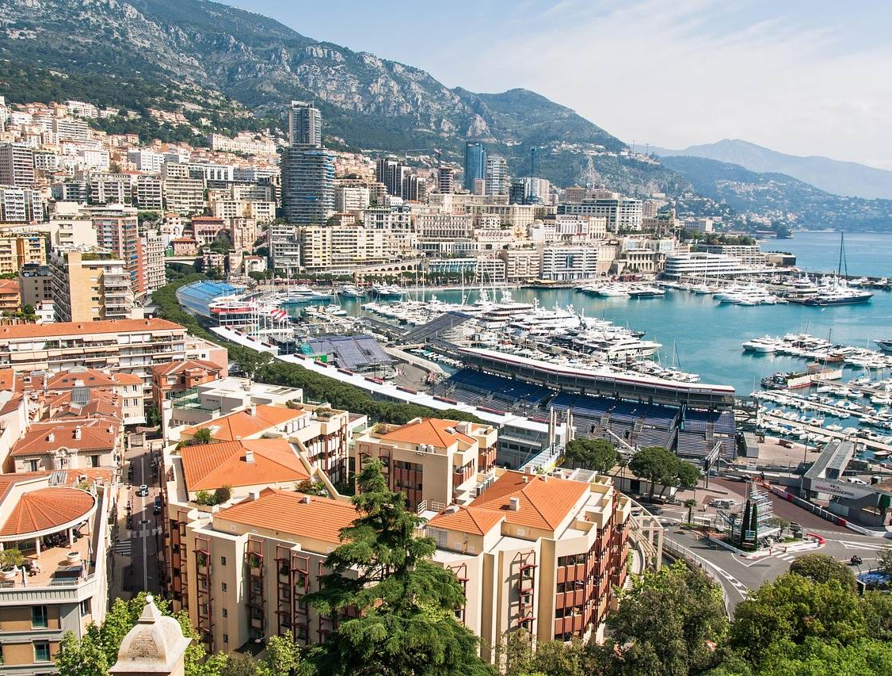
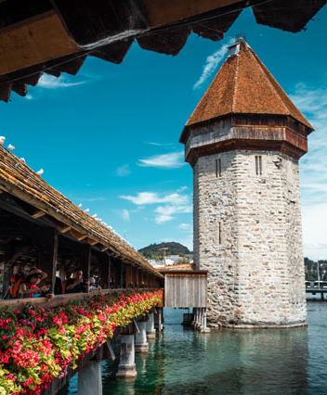
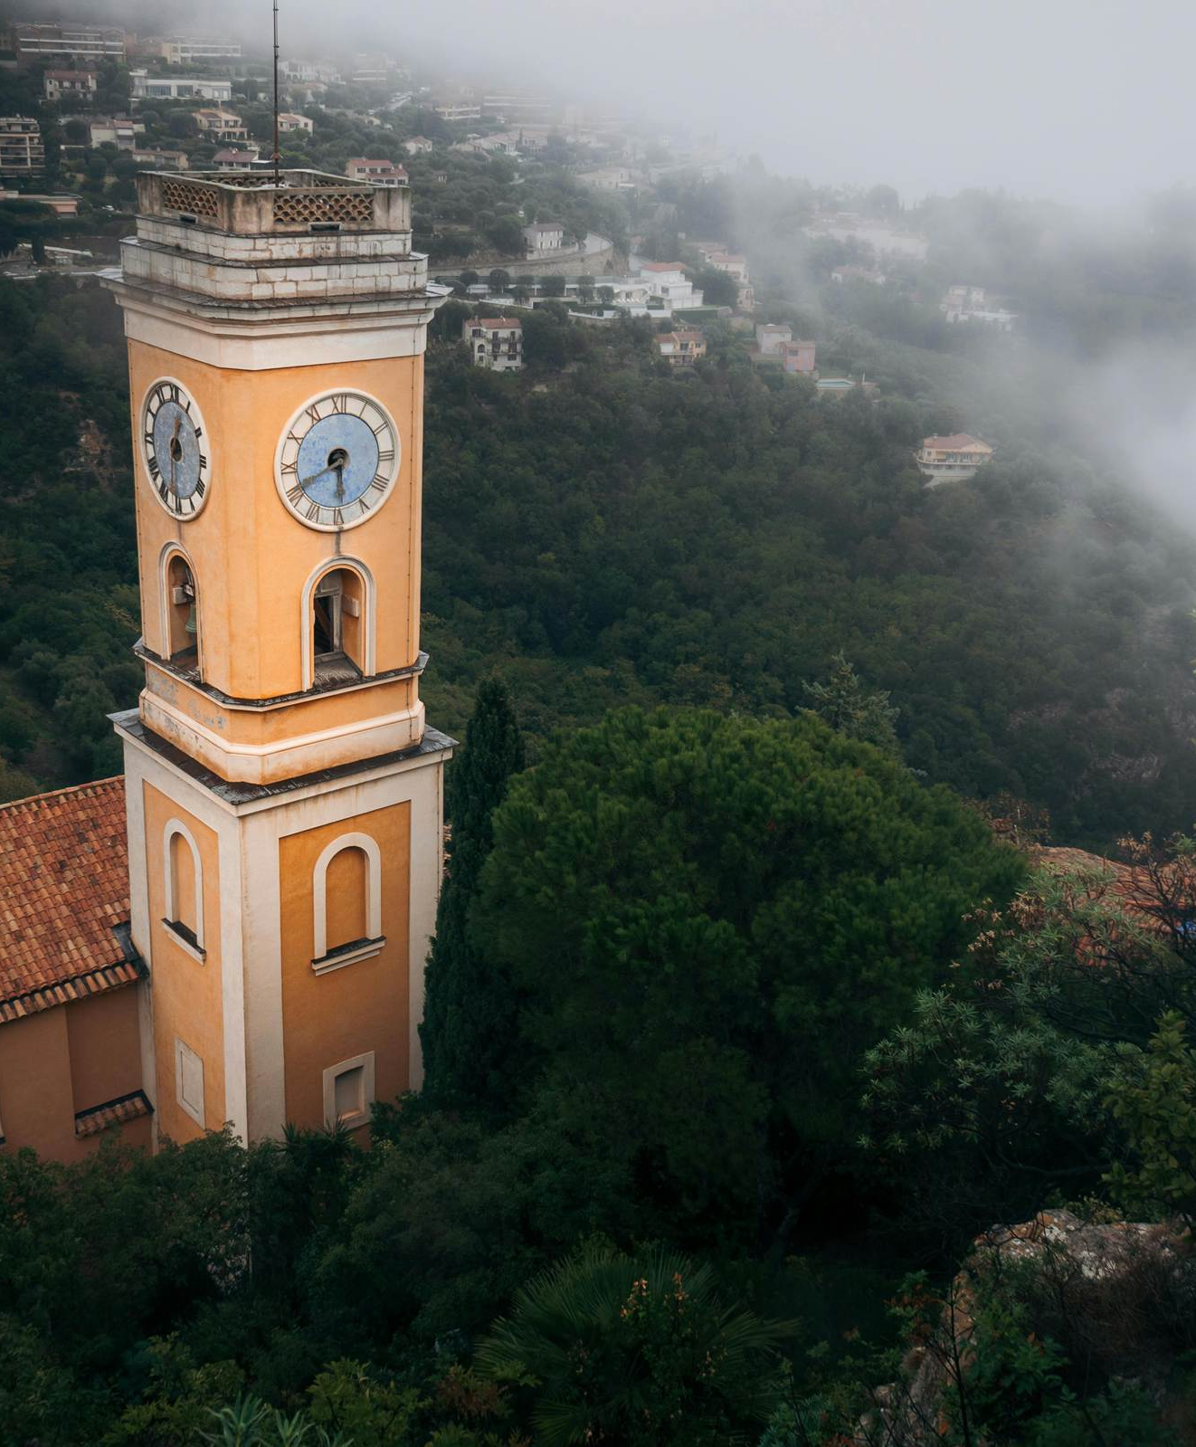
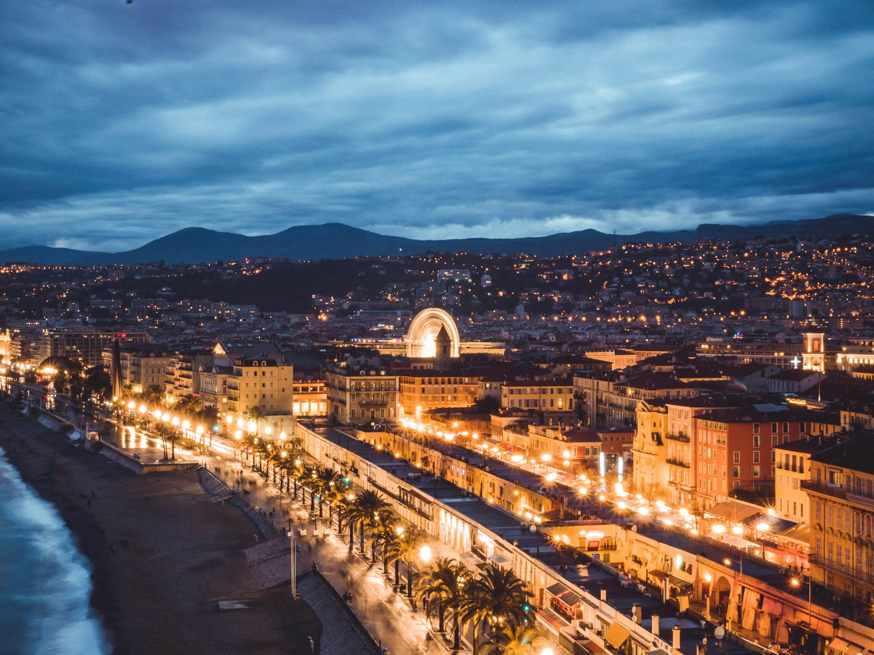
Trip highlights

Slide 21
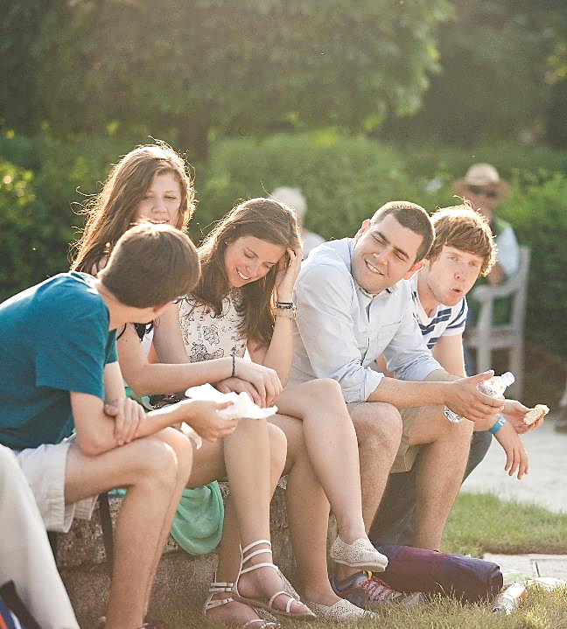

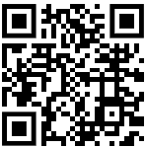
You’re going to
Switzerland, Italy and France!
Your enrollment number: 2930105FH
Need help enrolling? Call our Traveller support Team at 1-800-263-2806.
Scan the QR code or visit eftours.ca/enrol to enrol now!
© 2023 Signum International AG | EF Educational Tours | eftours.ca
Registration Numbers: TICO-2395858 | CPBC-73991 | OPC-70273
Notes:
Speaker: So, who’s ready to join us?!
Now is the perfect time to start planning.
You can head to the enrolment page on your computer or phone—or just scan the QR code here, and it’ll take you straight to the page!
All the enrolment details are also on the handout, so please make sure to grab one before you go. Does anyone have any questions before we wrap up?
Make sure to sign up early to secure your spot and take advantage of the early enrolment discount, which ends on: ______________.
The enrolment page will cover everything you need to know about our tour.
Thank you all so much for coming to the travel meeting—I hope to see you on this amazing trip!
(Direction: Play destination-themed music)

